Slide 1


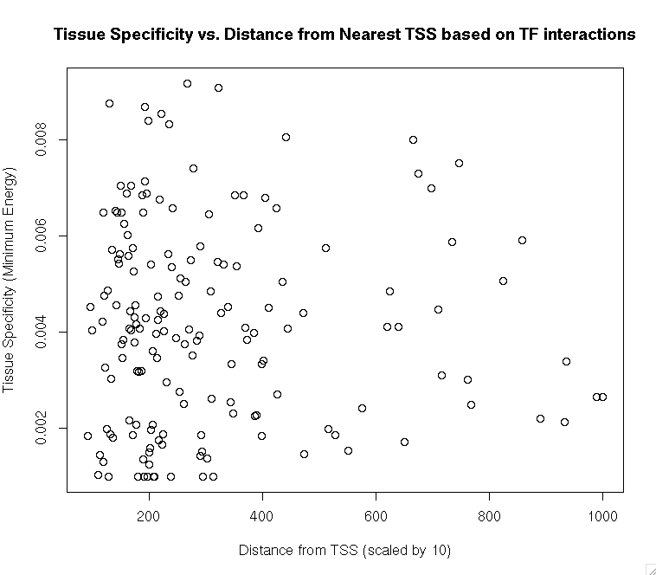
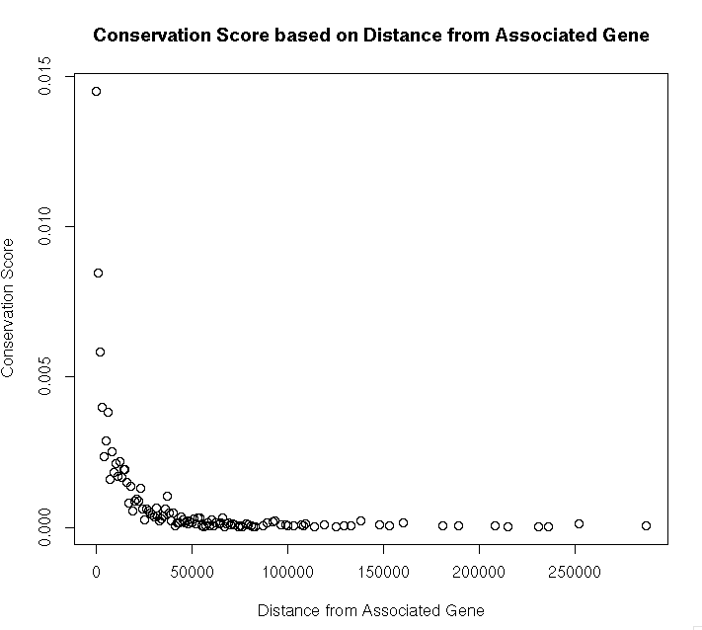
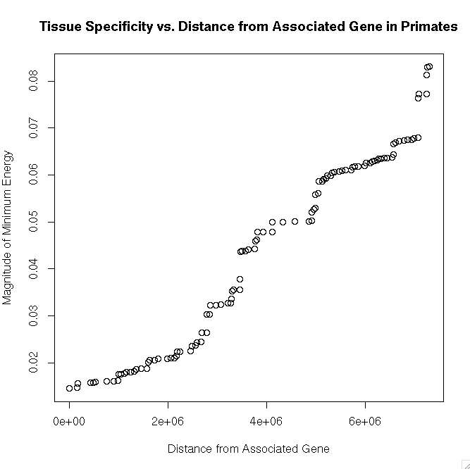
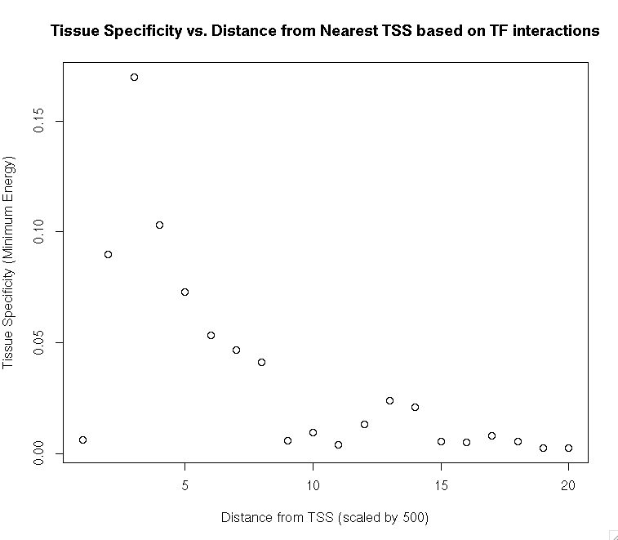
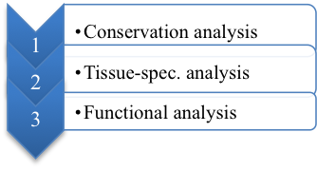
Analyzing the Evolutionary Conservation and Tissue-Specificity of Regulatory Clusters
Dilip Thiagarajan, Class of 2015
TJHSST Biotechnology and Life Sciences Laboratory, Alexandria, VA
Context
Results
Figure 3. Tissue Specificity based on TF interactions vs. distance from TSS
Statistical Analysis
Previous work analyzed significance of single, regulatory elements with respect to evolutionary conservation and tissue-specificity, but never interactions between regulatory elements (clusters). If elements were closer to their associated gene, they showed more likelihood of conservation (Mclean, Bristor, 2010), but non-conserved elements were more likely to be tissue-specific (Yu, Lin, Zack et. al., 2006). However, there is no precedent of the same correlation being valid for regulatory clusters.
Each dataset needed a correlation analysis to confirm the similarity to the analysis of singleton elements and to identify any interesting fitting functions.
Figure 1. Conservation Score based on Distance from Associated Gene
Conclusions
Figure 1 confirms the correlation between conservation and the distance from the associated gene. Figure 2 confirms the tendency for non-conserved elements to be more tissue-specific. Figures 3 and 4 shows a novel fitting function, and is related to the fitting functions of figures 1 and 2 based on an infinite approximation, assuming tissue-specific TF’s operate independently.
TF interaction affinity with clusters based on distance from associated TSS.
Probability of conservation based on distance from gene.
Figure 4. Tissue Specificity based on TF interactions with clusters in bins of 500 base pairs vs. distance from TSS
Hypothesis
Figure 2. Tissue Specificity based on Distance from Associated Gene
Clusters of regulatory elements would show the same properties as single elements on average.
Major Citations
Mclean, C., & Bristor, D. (2010, May).
Yu, X., Lin, J., Zack, D. J., & Qian, J. (2006, September).
Methods
Acknowledgements
Energy of binding tissue-related molecules based on distance from gene.
Dr. Andrea Cobb
Dr. Ivan Ovcharenko
Condensed version of Figure 3.

